Slide 1
AZ-300T04 M 3: Using Azure Kubernetes Service
Creating an Azure Kubernetes Service Cluster
Azure Container Registry
Azure Container Instances

Slide 2
Lesson 1: Creating an Azure Kubernetes Service Cluster
About Azure Kubernetes Service
Deploy an AKS cluster using Azure CLI
Deploy an AKS cluster using Azure Portal

Slide 3
About Azure Kubernetes Service
Managed Kubernetes cluster hosted in Azure with a range of benefits:
Flexible deployment options
Identity and security management
Integrated logging and monitoring
Cluster node scaling
Cluster node upgrades
HTTP application routing
GPU enabled nodes
Development tooling integration
Virtual network integration
Private container registry

Slide 4
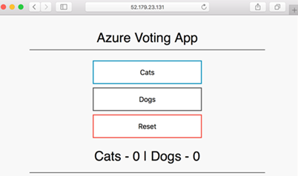
Deploy an AKS cluster using Azure CLI
Implementation steps:
1. Create a resource group:
az group create --name myAKSCluster --location eastus
2. Create an AKS cluster:
az aks create --resource-group myAKSCluster --name myAKSCluster --node-count 1 --enable-addons monitoring --generate-ssh-keys
3. Connect to the AKS cluster:
az aks get-credentials --resource-group myAKSCluster \ --name myAKSCluster
4. Create a Kubernetes manifest file (azure-vote.yaml)
5. Run the containerized application:
kubectl apply -f azure-vote.yaml
6. Monitor the progress of the deployment:
kubectl get service azure-vote-front –watch
7. Monitor health and logs (from the Azure portal)

Slide 5
Deploy an AKS cluster using Azure Portal
Implementation steps:
1. Create a resource > Kubernetes Service:
Basics: Project details, Cluster details, Scale
Authentication: A new or existing service principal and RBAC settings
Networking: Http application routing and Network configuration (Basic or Advanced)
Monitoring: A new or existing Log Analytics workspace.
2. Connect to the cluster:
az aks get-credentials --resource-group myAKSCluster \ --name myAKSCluster
3. Create a Kubernetes manifest file (azure-vote.yaml)
4. Run the containerized application:
kubectl apply -f azure-vote.yaml
5. Monitor health and logs (from the Azure portal)

Slide 6
Lesson 2: Azure Container Registry
Azure Container Registry overview
Deploy an image to ACR using Azure CLI

Slide 7
Azure Container Registry overview
Key concepts:
Registry
Repository
Image
Container
ACR is a managed container registry based on Docker Registry 2.0:
Integrates with Azure Container Registry Build (for building container images)
Is available in three service tiers: Basic, Standard, and Premium
Offers:
Webhook integration
Azure AD authentication
Delete functionality
Geo-replication (with the Premium tier)

Slide 8
Deploy an image to ACR using Azure CLI
docker push <acrLoginServer>/aci-helloworld:v1
Implementation steps:
1. Create a resource group:
az group create --name myResourceGroup --location eastus
2. Create a container registry:
az acr create --resource-group myResourceGroup --name myContainerRegistry007 --sku Basic
3. Log in to ACR:
az acr login --name <acrName>
4. Push a new image to ACR (or pull and tag an existing image first):
docker pull microsoft/aci-helloworld
docker tag microsoft/aci-helloworld <acrLoginServer>/aci-helloworld:v1
docker push <acrLoginServer>/aci-helloworld:v1
5. Deploy a container by using an image in ACR:
az container create --resource-group myResourceGroup --name acr-quickstart --image <acrLoginServer>/aci-helloworld:v1 --cpu 1 --memory 1 --registry-username <acrName> --registry-password <acrPassword> --dns-name-label aci-demo --ports 80

Slide 9
Lesson 3: Azure Container Instances
Azure Container Instances Overview
Implement an application using Virtual Kubelet

Slide 10
Azure Container Instances Overview
A managed container hosting option offering a range of benefits:
Fast startup times
Public IP connectivity and DNS name
Hypervisor-level security
Custom sizes
Persistent storage
Linux and Windows containers
Co-scheduled groups

Slide 11
Implement an application using Virtual Kubelet
Virtual Kubelet provider is an experimental open source project:
Allows scheduling AKS-managed containers on Azure Container Instances
Combines functional benefits of AKS with low pricing of ACI
Supports both Windows and Linux containers
To install the Virtual Kubelet provider:
Ensure that the prerequisites are satisfied:
An existing AKS cluster
Azure CLI version 2.0.33 and Helm installed
A service account and role binding for use with Tiller (for RBAC-enabled AKS clusters)
Run the az aks install-connector command:
az aks install-connector --resource-group myAKSCluster --name myAKSCluster --connector-name virtual-kubelet --os-type Both
Once the installation completes, you can deploy Windows and Linux containers to ACI:
In the .yaml file, replace kubernetes.io/hostname with the name of the Linux/Windows Virtual Kubelet node

Slide 12
Azure API Management (APIM)
Streamlines the process of common tasks necessary for creating an API for external use
Tasks include:
Creating a successful and useful developer portal
Securing API endpoints from anonymous or unwanted access
Managing existing developer access through cache mechanisms, throttling and other policies
Building a monitoring and analytics platform to diagnose issues and monitor adoption
Providing business users and developers with deep insights into how each API is specifically used

Slide 13
Creating an API Management Instance
Create and manage APIs
Each API contain one or more sets operations
Operations are configurable granting control over:
URL mapping
Query and path parameters
Request and response content
Operation response caching

Slide 14
API Management Products
Contains one or more APIs in a package
Products can be open or protected
Open products are free to use without any subscription
Protected products must be subscribed to before use
When a product is ready for developers, it can be published for use

Slide 15
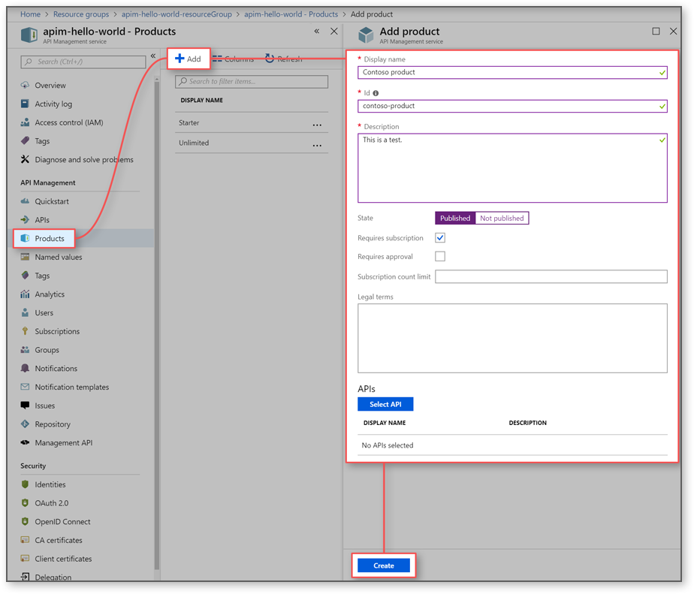
Create and Publish a Product
In Azure API Management, a product contains one or more APIs as well as a usage quota and the terms of use. Once a product is published, developers can subscribe to the product and begin to use the product's APIs.
In this topic, you learn how to:
Create and publish a product
Add an API to the product

Slide 16
API Management Policies
Collection of statements that are executed sequentially at the request or response of an API
Are a quick way to change the behavior of an API without code changes to the actual back-end API application
A comprehensive list of policy options can be found here: https://docs.microsoft.com/azure/api-management/api-management-policies

